Slide 1
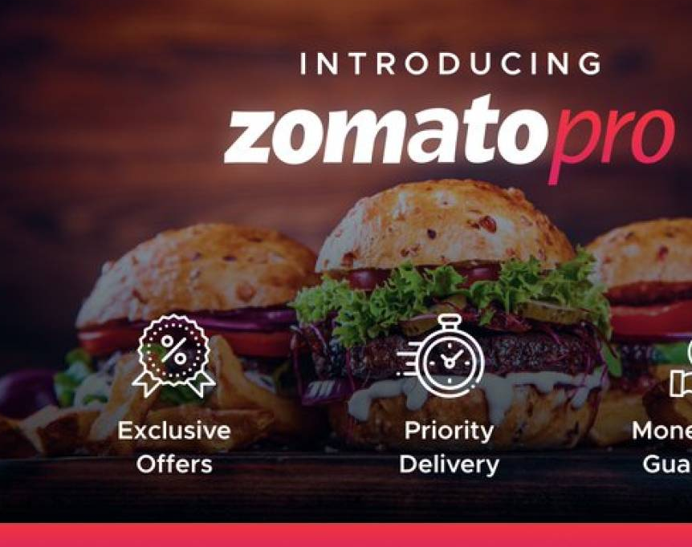





Zomato Client Performance Analysis
Zomato Company Overview
Business Objective
Data Model And Transformation
Insight And Suggestions
Dashboard

Slide 2
Contents
Introduction:
Launched in 2010.
Customer Engagement:
Order food, book tables, make payments.
Search, discover, and review.
Connects customers, restaurants, and delivery partners.
Restaurant Partner Benefits:
Hyperpure for procurement.
Marketing tools for engagement.
Reliable last-mile delivery.
Zomato Company Overview
Business Objective
Data Model And Transformation
Insight And Suggestions
Dashboard

Slide 3
Zomato Company Overview
Introduction:
Launched in 2010.
Customer Engagement:
Order food, book tables, make payments.
Search, discover, and review.
Connects customers, restaurants, and delivery partners.
Restaurant Partner Benefits:
Hyperpure for procurement.
Marketing tools for engagement.
Reliable last-mile delivery.
Delivery Partner Opportunities:
Hyperpure:
Platform Ecosystem:
Growth and Impact:
Transparent, flexible earning.
One-stop procurement.
High-quality ingredients and products.
Visual representation of interconnected stakeholders.
Milestones and impact metrics.
Numbers of customers and partners.

Slide 4

Zomato Company Overview
Introduction:
Launched in 2010.
Customer Engagement:
Order food, book tables, make payments.
Search, discover, and review.
Connects customers, restaurants, and delivery partners.
Restaurant Partner Benefits:
Hyperpure for procurement.
Marketing tools for engagement.
Reliable last-mile delivery.
Delivery Partner Opportunities:
Hyperpure:
Platform Ecosystem:
Growth and Impact:
Transparent, flexible earning.
One-stop procurement.
High-quality ingredients and products.
Visual representation of interconnected stakeholders.
Milestones and impact metrics.
Numbers of customers and partners.
Data Accuracy Challenge: Managing a vast number of restaurants poses difficulties in maintaining accurate and up-to-date information.
Continuous Onboarding Need: Annual opening of new restaurants requires constant onboarding and management efforts.
Varied Restaurant Ratings: Diverse average ratings may result in inconsistencies, affecting recommendations and user experiences.
Regular Bucket Updates: Bucket ranges and grades for restaurants need frequent updates to ensure fairness and accuracy.
Global Operation Challenges: Operating in multiple countries brings challenges related to local regulations, cultural differences, and market dynamics.

Slide 5

Business Problem
Efficient Listing Management: Develop a robust system for managing and updating restaurant listings to ensure accuracy.
Streamlined Onboarding: Create a streamlined onboarding process for new restaurants, incorporating automated data integration.
Rating Validation System: Implement algorithms for regular monitoring and validation of restaurant ratings, ensuring reliable recommendations.
Automated Grade Updates: Establish clear criteria for bucket ranges and grades, automating the updating process based on performance changes.
Adaptation to Local Dynamics: Tailor business strategies to specific country needs, conducting thorough research for effective operations in diverse markets.
Data Accuracy Challenge: Managing a vast number of restaurants poses difficulties in maintaining accurate and up-to-date information.
Continuous Onboarding Need: Annual opening of new restaurants requires constant onboarding and management efforts.
Varied Restaurant Ratings: Diverse average ratings may result in inconsistencies, affecting recommendations and user experiences.
Regular Bucket Updates: Bucket ranges and grades for restaurants need frequent updates to ensure fairness and accuracy.
Global Operation Challenges: Operating in multiple countries brings challenges related to local regulations, cultural differences, and market dynamics.
Delivery Partner Opportunities:
Hyperpure:
Platform Ecosystem:
Growth and Impact:
Transparent, flexible earning.
One-stop procurement.
High-quality ingredients and products.
Visual representation of interconnected stakeholders.
Milestones and impact metrics.
Numbers of customers and partners.
This Photo by Unknown author is licensed under CC BY-SA-NC.

Slide 6
Project Scope
1. Implement stricter quality control measures to maintain the standard of restaurants listed on the platform.
2. Provide support and resources to new restaurants to help them improve their ratings and establish a strong presence on the platform.
3. Offer personalized recommendations and promotions to customers based on their preferences and the quality of restaurants.
4. Expand business operations in countries with high growth potential and establish partnerships with local restaurants to enhance the platform's offerings.
Efficient Listing Management: Develop a robust system for managing and updating restaurant listings to ensure accuracy.
Streamlined Onboarding: Create a streamlined onboarding process for new restaurants, incorporating automated data integration.
Rating Validation System: Implement algorithms for regular monitoring and validation of restaurant ratings, ensuring reliable recommendations.
Automated Grade Updates: Establish clear criteria for bucket ranges and grades, automating the updating process based on performance changes.
Adaptation to Local Dynamics: Tailor business strategies to specific country needs, conducting thorough research for effective operations in diverse markets.
This Photo by Unknown author is licensed under CC BY-SA-NC.
Data Accuracy Challenge: Managing a vast number of restaurants poses difficulties in maintaining accurate and up-to-date information.
Continuous Onboarding Need: Annual opening of new restaurants requires constant onboarding and management efforts.
Varied Restaurant Ratings: Diverse average ratings may result in inconsistencies, affecting recommendations and user experiences.
Regular Bucket Updates: Bucket ranges and grades for restaurants need frequent updates to ensure fairness and accuracy.
Global Operation Challenges: Operating in multiple countries brings challenges related to local regulations, cultural differences, and market dynamics.

Slide 7
Insight And Suggestions
Efficient Listing Management: Develop a robust system for managing and updating restaurant listings to ensure accuracy.
Streamlined Onboarding: Create a streamlined onboarding process for new restaurants, incorporating automated data integration.
Rating Validation System: Implement algorithms for regular monitoring and validation of restaurant ratings, ensuring reliable recommendations.
Automated Grade Updates: Establish clear criteria for bucket ranges and grades, automating the updating process based on performance changes.
Adaptation to Local Dynamics: Tailor business strategies to specific country needs, conducting thorough research for effective operations in diverse markets.
1. Implement stricter quality control measures to maintain the standard of restaurants listed on the platform.
2. Provide support and resources to new restaurants to help them improve their ratings and establish a strong presence on the platform.
3. Offer personalized recommendations and promotions to customers based on their preferences and the quality of restaurants.
4. Expand business operations in countries with high growth potential and establish partnerships with local restaurants to enhance the platform's offerings.
This Photo by Unknown author is licensed under CC BY-SA-NC.

Slide 8


